Slide 1
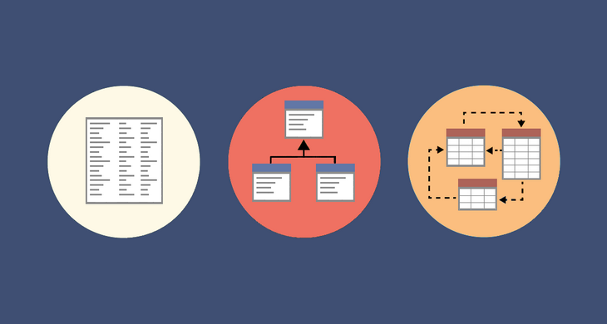
Data Modelling
The Fundamentals

Slide 2
Do the following Udemy Course
https://deloittedevelopment.udemy.com/course/mastering-data-modeling-fundamentals/learn/lecture/17729418#overview

Slide 3
Questions?

